Slide 1
TRENDS IN GLOBAL AUTOMATION TO YEAR 2020
Prepared by Piergiuseppe (Pino) Zani
May 31, 2013

Slide 2
Trends in global Automation to year 2020
This contribution intends to be a comprehensible summary based on several references.
The various mentioned new technologies are not introduced in detail.
Intentionally there are not mention to markets and potential business.

Slide 3
The future of Automation started few years ago.
INCREASING DATA LOADS AND DEMANDS FOR INTEGRATION.
Data load= I/O count, I/O ratio, history, visualization, property: state ratio, etc.
Level of integration.
LOW-COST STATE AND PROPERTY MESASUREMENTS.
Process efficiency expands to include business performance.
Systems and application integration essential.
APPLICATIONS REVOLVE AROUND.
Decision support systems.
Work flow embedded ( a la ISA95)
CROSS-DISCIPLINARY COLLABORATION ENABLED
USE OF REMOTE EXPERTISE
DECENTRALIZED PLANT OPERATIONS
NEW VISUALIZATION WILL EMERGE
NEW TOOLS TO CONVERT VAST AMOUNTS OF DATA INTO INFORMATION

Slide 4
...Enabled by the Nexus of Technologies…
Internet
  XML
  Java
  Portals
Hardware
  Performance
  Capacity
Operating Systems
  Increased services (SOA)
  Work flows
  Scorecarding
  Collaboration
Emerging Industrial Standards
Heightened Security
  Dependence on:
    Person
    Location
    Time of day
Delivers:
Enterprise Performance
Excellence
Shorter time constants:
Better, real time decisions
Whole new operating methods
Human behavior OpEx
Faster time-to-profit
Networks
  Ever higher speeds
  Ubiquitous
Process operations
state-of-the-art
Enterprise control
Visualization
  Ubiquitous
  Large surfaces
  3- & 4-d representations
  Virtual placements
Sensors
  Dramatically lower costs
  Self identifying
  Property sensing
  Greatly increased I:O
Collapse of telephony
  Video
  Computing
  Voice input/output
Enterprise Control
System
Wireless
  Freedom of movement
  Location independence

Slide 5

Automating the Business Control Loop
Enterprise /
Supply Chain
Optimization
EPS Calculator
Earnings per Share
KPIs
Performance Measures
Actual
Forecast
Executive Level
Business Control Loop
Δ = Actual – Forecast = Variance
Asset
Optimization
Gross Profit Calculator
Gross Profit
Actual
Forecast
Business Management Level
Δ = Actual – Forecast = Variance
Throughput
(Fixed Cost Contribution to Mfg. Cost)
Energy Cost Contribution
To Mfg. Cost
Raw Mat’l Cost Contribution
To Mfg. Cost
Process
Optimization
PV
SP
PV
PV
5
I
S
SP
9
SP
Plant Management
Level
A
Δ = PV – SP = Deviation
Δ = PV – SP = Deviation
Regulatory &
Advanced Process
Control
Column 301-D
Reboiler Outlet Temp.
Process Management Level
PV
SP
Δ = PV – SP = Deviation

Slide 6
The future of Automation started few years ago (Continued)
Today those new technologies, hardware and software are being continuously implemented.
IT and ICT will have more and more presence and influence.
There will be continuous implementation through Cloud and Virtualization.
Also the HMI/SCADA are changing to have operative knowledge availability always and everywhere.
HMI, human machine interface.
ICT, information and communication technology.
SCADA, Supervisory control and data acquisition

Slide 7
The future of Automation started few years ago (Continued)
SMART FACTORIES
The factories of the future will frive the future.
An advanced manufacturing industry is the premise of a country’s economical development.
The evolution of the Smart Factories are those for energy self-production, more and more connected with production sites, energy saving technologies and, of course, automation technologies, the contribution of which deals with the transformation of processes even in the most traditional fields.

Slide 8
The future of Automation started few years ago (Continued)
Among the most relevant are:
SECURE CLOUD COMPUTING.
NEW STANDARDS OF THE INTERNET OF THING.
NEW STANDARDS OF WIRELESS TECHNOLOGIES.
INTERNET BASED FACTORY NETWORKING BASED ON IOS AND IOT.
IN ADDITION TO THE RECENT DESIGN AND SIMULATION DEVICES

Slide 9
The future of Automation started few years ago (End)
INDUSTRIAL CYBERSECURITY
VERY IMPORTANT ASPECT IS THE ATTENTION GIVEN AND ACTIONS INTRODUCED TO CONTINUE TO IMPROVE THE PROTECTION FOR THE SECURITY OF INDUSTRIAL AUTOMATION AND CONTROL SYSTEMS (IACS) AT AL PHASES OF THEIR LIFE CYCLES, FROM DESIGN AND IMPLEMENTATION TO OPERATION AND SUPPORT.
ISA , THE INTERNATIONAL SOCIETY OF AUTOMATION, IS DEVELOPING A COMPREHENSIVE SET OF AMERICAN NATIONAL STANDARDS AND TECHNICAL REPORTS isa))/iec62443 THAT ADDRESS WHAT IT IS NEEDED.
More information from ISA brochure: Industrial Cybersecurity Technical Resources.

Slide 10
At this point let me show few slides that are usually used to document all the changes from Industry 1.0 to Industry 4.0

Slide 11

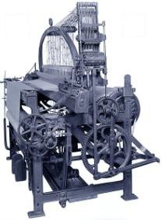




From Industry 1.0 to Industry 4.0: Towards the 4th Industrial Revolution
Degree of Complexity
First Mechanical Loom
1784
1. Industrial Revolution mechanical production facilities powered by water and steam
Industry 1.0
End of
18th
Century
t

Slide 12
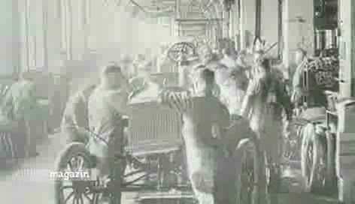
From Industry 1.0 to Industry 4.0: Towards the 4th Industrial Revolution
Degree of Complexity
First Mechanical Loom
1784
2. Industrial Revolution
mass production
based on the division
of labor powered by
electrical energy
Industry 2.0
1. Industrial Revolution mechanical production facilities powered by water and steam
Industry 1.0
End of
18th
Century
Start of
20th
Century
t

Slide 13
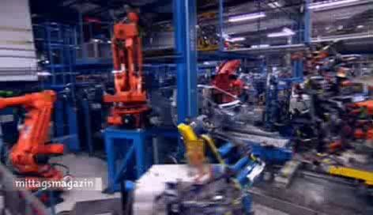
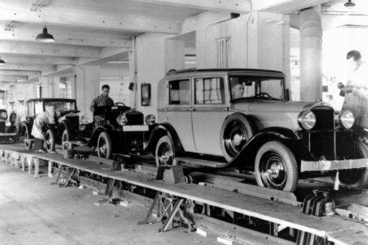
From Industry 1.0 to Industry 4.0: Towards the 4th Industrial Revolution
Degree of Complexity
3. Industrial Revolution
electronics and IT and heavy- duty industrial robots for a further automization
of production
Industry 3.0
First Mechanical Loom
1784
2. Industrial Revolution
mass production
based on the division
of labour powered by
electrical energy
Industry 2.0
1. Industrial Revolution mechanical production facilities powered by water and steam
Industry 1.0
End of
18th
Century
Start of
20th
Century
Start of
70s
t

Slide 14
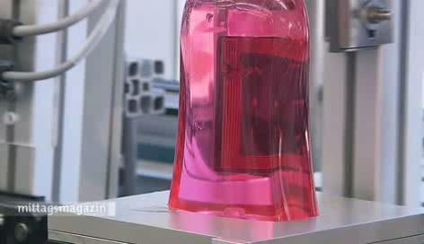
From Industry 1.0 to Industry 4.0: Towards the 4th Industrial Revolution
4. Industrial Revolution based on Cyber-Physical Production Systems
Degree of Complexity
010001101
001010100
100101010
010010101
3. Industrial Revolution
electronics and IT and heavy- duty industrial robots for a further automization
of production
Industry 3.0
First Mechanical Loom
1784
2. Industrial Revolution
mass production
based on the division
of labor powered by
electrical energy
Industry 2.0
1. Industrial Revolution mechanical production facilities powered by water and steam
Industry 1.0
End of
18th
Century
Start of
20th
Century
Start of
70s
today
t

Slide 15
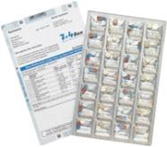
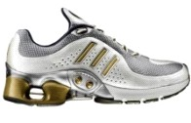

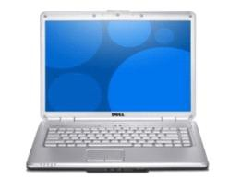
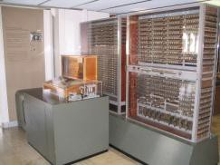

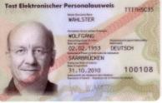
Towards Intelligent Environments based on the Internet of Things and Services
5) Intelligent
Environments
Smart Factory
4) Embedded Computers
1) Central Computer
2) PC, Notebook
90% of all computers are
embedded
3) Smart Phone
Smartcard
1 Computer
Many Users
1 Computer
1 User
Many Computers, 1 User
1941
1960
1980
2000
2020

Slide 16
CONCLUSION
THE RANGE OF TECHNOLOGIES INVOLVED IN THE EVOLUTION IN OUR FACTORIES IS ON THE WAY AND WILL STRENGTHEN THE INDUSTRIES SIGNIFICANTLY IN TERMS OF COMPETITIVENESS.
ESPECIALLY THE USE OF CYBER PHYSICAL SYSTEMS, THAT IS THE APPLICATION OF DISTRIBUTED BUT INTERLINKED INTELLIGENT OBJECTS, WILL REVOLUTIONIZE THE FACTORY OF THE FUTURE FUNDAMENTALLY.
WE WILL SEE
SMART PRODUCTION: HIGH-PRECISION, SUPERIOR QUALITY PRODUCTION OF HIGH MIX, LOW VOLUME SMART PRODUCTS.
URBAN PRODUCTION: SMART FACTORIES IN THE CITY CLOSE TO THE EMPLOYEES’ HOMES.
GREEN PRODUCTION: CLEAN, RESOURCE-EFFICIENT, AND SUSTAINABLE.
GREEN ECONOMY.

Slide 17
TRENDS IN GLOBAL AUTOMATION TO YEAR 2020
SOURCES
Jim Pinto: www.jimpinto.com/writings/automation.html
Wolfgang Wahlster: http://www.dfki.de/~wahlster/
Magazine InMotion, April 2013
ISA: www.isa.org

Slide 18
TRENDS IN GLOBAL AUTOMATION TO YEAR 2020
THANK YOU
FOR YOUR TIME AND ATTENTION

